Slide 1
Parallel execution
Programming Language Design and Implementation (4th Edition)
by T. Pratt and M. Zelkowitz
Prentice Hall, 2001
Section 11.2.1

Slide 2
Parallel programming principles
Variable definitions. Variables may be either mutable or definitional. Mutable variables are the common variables declared in most sequential languages. Values may be assigned to the variables and changed during program execution. A definitional variable may be assigned a value only once.
Parallel composition. We need to add the parallel statement, which causes additional threads of control to begin executing.
Program structure. They may be transformational to transform the input data into an appropriate output value. Or it may be reactive, where the program reacts to external stimuli called events.
Communication. Parallel programs must communicate with one another. Such communication will typically be via shared memory with common data objects accessed by each parallel program or via messages.
Synchronization. Parallel programs must be able to order the execution of its various threads of control.

Slide 3
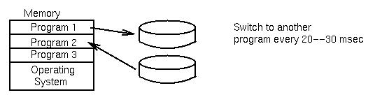
Impact of slow memories
Historically - CPU fast
Disk, printer, tape - slow
What to do while waiting for I/O device? - Run another program:
Even today, although machines and memory are much faster, there is still a 10⁵ or more to 1 time difference between the speed of the CPU and the speed for accessing information from disk. For example,
Instruction time: 50 nanosecond
Disk access: 10 milliseconds = 10,000,000 nanoseconds

Slide 4
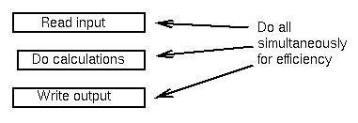
Multiprogramming
Now:
Multiple processors
Networks of machines
Multiple tasks simultaneously
Problems:
1. How to switch among parts effectively?
2. How to pass information between 2 segments?
Content switching of environments permitting concurrent execution of separate programs.

Slide 5
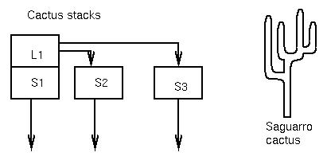
Parallel constructs
Two approaches (of many):
1. AND statement (programming language level)
2. fork function (UNIX) (operating system level)
and: Syntax: statement1 and statement2 and statement3
Semantics: All statements execute in parallel.
Execution goes to statement following and after all parallel parts terminate.
S1; S1 and S2 and S3; S4 ⇒ S4 after S1, S2, and
S3 terminate
⇒ Implementation: Cactus stack

Slide 6
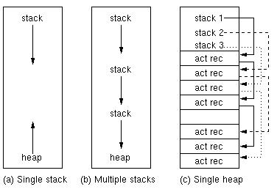
Parallel storage management
Use multiple stacks. Can use one heap (c)

Slide 7
“and” statement execution
After L1, add S1, S2, S3 all onto stack.
Each stack is independent.
How to implement? ⇒ Heap storage is one way for each
activation record.
2. fork() function:
{ S1; fork();
if I am parent process
do { main task;
sleep until child process terminates if I am child process do { exec new process
S2 ⇒ S2 executes when both parent and child
process terminate above action
Both parent process and child process execute independently

Slide 8
Tasks
A task differs little from the definition of an ordinary subprogram
independent execution (thread of control)
requires task synchronization and communication with other tasks - will look at communication later (semaphores)
has separate address space for its own activation record

Slide 9
Ada tasks
task Name is
- Declarations for synchronization and communication
end;
task body Name is
- Usual local declarations as found in any subprogram
begin
--Sequence of statements
end;
Syntax same as Ada packages
Initiating a task:
task type Terminal is
-- Rest of definition in the same form as above
end;
Creating task data:
A: Terminal;
B, C: Terminal;
“Allocating” task objects creates their execution.

Slide 10
Coroutines
Normal procedure activation works as Last-in First-out (LIFO) execution.
  Different from parallel execution - single thread of control
  Call procedure
  Do action
  Exit procedure
Consider following example:
  Input process reads from 3 different files
  Output process writes to 4 different files
Input process Output process

Slide 11
Execution of each process
Read process Write process
while true do while true do
begin begin
read(A,I) resume input(I)
resume output(I) write(W,I)
read(B,I) resume input(I)
resume output(I) write(X,I)
read(C,I) resume input(I)
resume output(I) write(Y,I)
end resume output(I)
write(Z,I)
end
If each process views the other as a subroutine, we call both of these processes coroutines.

Slide 12
Implementation of coroutines - Instructions
Resume output
Resume output
Resume output
Resume output
Resume output
Resume output
Resume output
Initial execution Second execution

Slide 13
Coroutine data storage
Build both activation records together (much like variant records)
For resume statement: Pick up a return address of coroutine in activation record and save current address as new return point in activation record
Activation record for input
read process resume address
Activation record for output
write process resume address

Slide 14
Guarded commands
Programming Language Design and Implementation (4th Edition)
by T. Pratt and M. Zelkowitz
Prentice Hall, 2001
Section 11.2.2

Slide 15
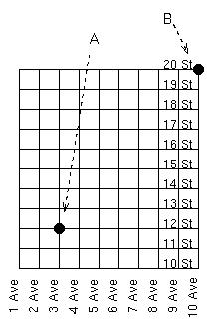
Nondeterministic Execution
Program execution is usually a sequential, deterministic process:S1, S2, S3, ...
Problem: Find a path from point A to point B:

Slide 16
Usual deterministic algorithms
Algorithm 1: Move right to correct column,
Move up to correct row.
Algorithm 2: Move up to correct row,
Move right to correct column.
You have no other way to think about problem, no other
constructs to help.
But there is a another nondeterministic approach:
Move right or up until correct row and column,
Then move straight to B.
Idea came from Dijkstra in 1972.
Use guard (⇒ and  ) on a statement:
P ⇒ S:
means S is executable if P is true.

Slide 17
Guarded IF statement
if p1 ⇒ s1  p2 ⇒ s2  p3 ⇒ s3  . . . fi
Semantics:
1. Some pi must be true.
2. Choose any pi that is true and execute si.
3. If all pi are false, program halts and fails.
Note that if p then s1 else s2 is just:
if p ⇒ s1  not(p) ⇒ s2 fi

Slide 18
Guarded repetition
do p1 ⇒ s1  p2 ⇒ s2  p3 ⇒ s3  . . . od
Semantics:
1. If all pi false, go to next statement.
2. Choose any pi that is true and execute si.
3. repeat execution of guarded do statement.
Random walk algorithm:
do current_row not B row ⇒ move up one row
 current_column not B column ⇒ move right one column
od
Solution must work, yet you cannot a priori know the exact sequence of paths the program will produce.

Slide 19
Guarded commands in Ada
Select -- select statement
when condition₁ => statement₁
or when condition₂ => statement₂
...
or when condition_{n} => statement_{n}
else statement_{n+1}
The use of this will become apparent when we discuss synchronization and Ada rendezvous.

